Slide 1
History and Physical Exam In Ophthalmic Disease
Heidrun Gollogly, M.D.
Children's Surgical Centre
No disclosures

Slide 2
The art of history taking
“Listen to your patient, they are telling you the diagnosis”
History as foundation for rapport with patient, diagnosis and management
Focused history
Confirmatory exam
Ancillary testing
> Diagnosis and management

Slide 3
“As we have become more and more dependent upon the laboratory and special investigations in making our diagnosis, we have gradually lost that faculty of clinical observation which enabled these early clinicians to make an accurate diagnosis in the more common diseases almost with a glance at the patient.” - Dr. Will Mayo
“Thus the specialist’s practice exacts wider knowledge of the body in health and disease; he must be able to examine the entire body…”- Dr. Charlie Mayo

Slide 4
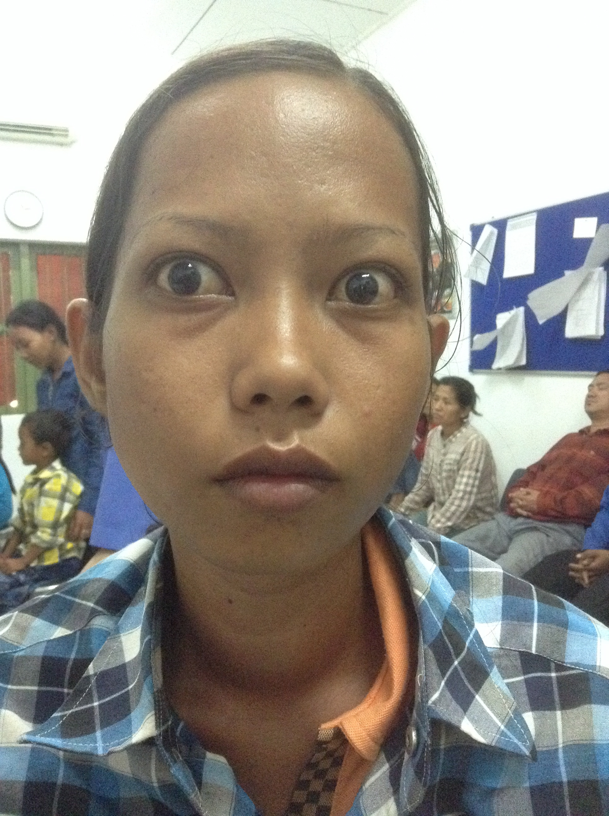
28 year old woman with eye irritation

Slide 5
History
Chief Complaint
History of Present Illness (HPI)
Ocular history
Medical history
Current medications
Current allergies
Family/social history
Review of systems
- eye irritation x2 wks
- negative
- negative
- none
- none
- none

Slide 6
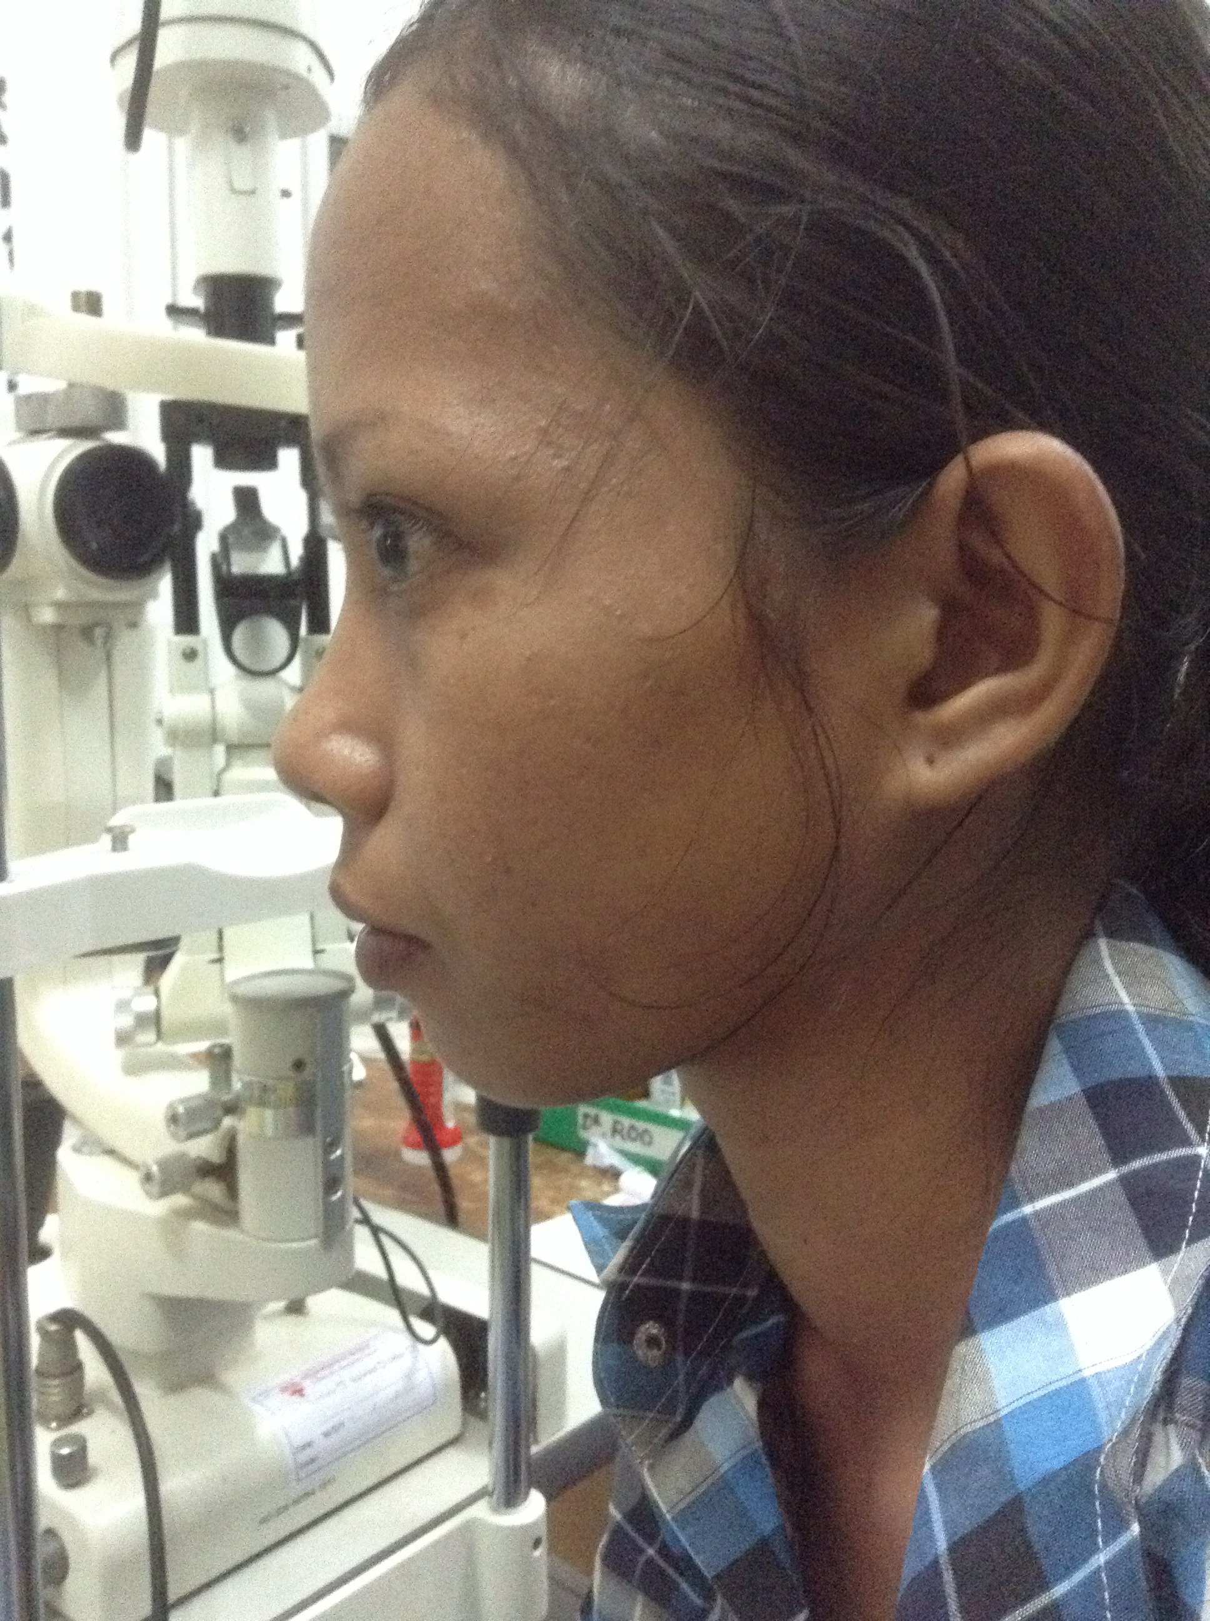
Blurred vision
Light sensitivity
Mild eye pain
Palpitations
Diarrhea
Moist palms
Hand trembles
Swelling of neck

Slide 7
Physical Exam
VA 6/6 OU
Pupils normal
Orthoptic, EOM full
Lid retraction, lid lag, trace lagophthalmos, mild proptosis
Minimal SPK inferior cornea, mild caruncular swelling, no conjunctival injection
Posterior exam normal
HR 177
BP 110/64
No acute distress
Warm moist hands, extremities swollen
Palpable thyroid
Slight tremor
Temperature

Slide 8
Ancillary Testing/Diagnosis
EKG
TSH, Free T4/T3
Graves Disease >> Thyroid Storm
Beta blockers, acetaminophen, hydrocortisone
PTU, methimazole
Thyroid surgery, radiation
Lubrication with artificial tears
Notes:
BB-tachycardia, CHF propanolol 60-80mg q4hrs
Acetamenophen-hyperthermia, preferred over salicylates which decrease thyroid protein binding (more FreeT4)
Hydrocortisone-decreases peripheral T4 to T3 conversion and has vasomotor stability, treats possible adrenal insufficiency
Antithyroid drug therapies

Slide 9
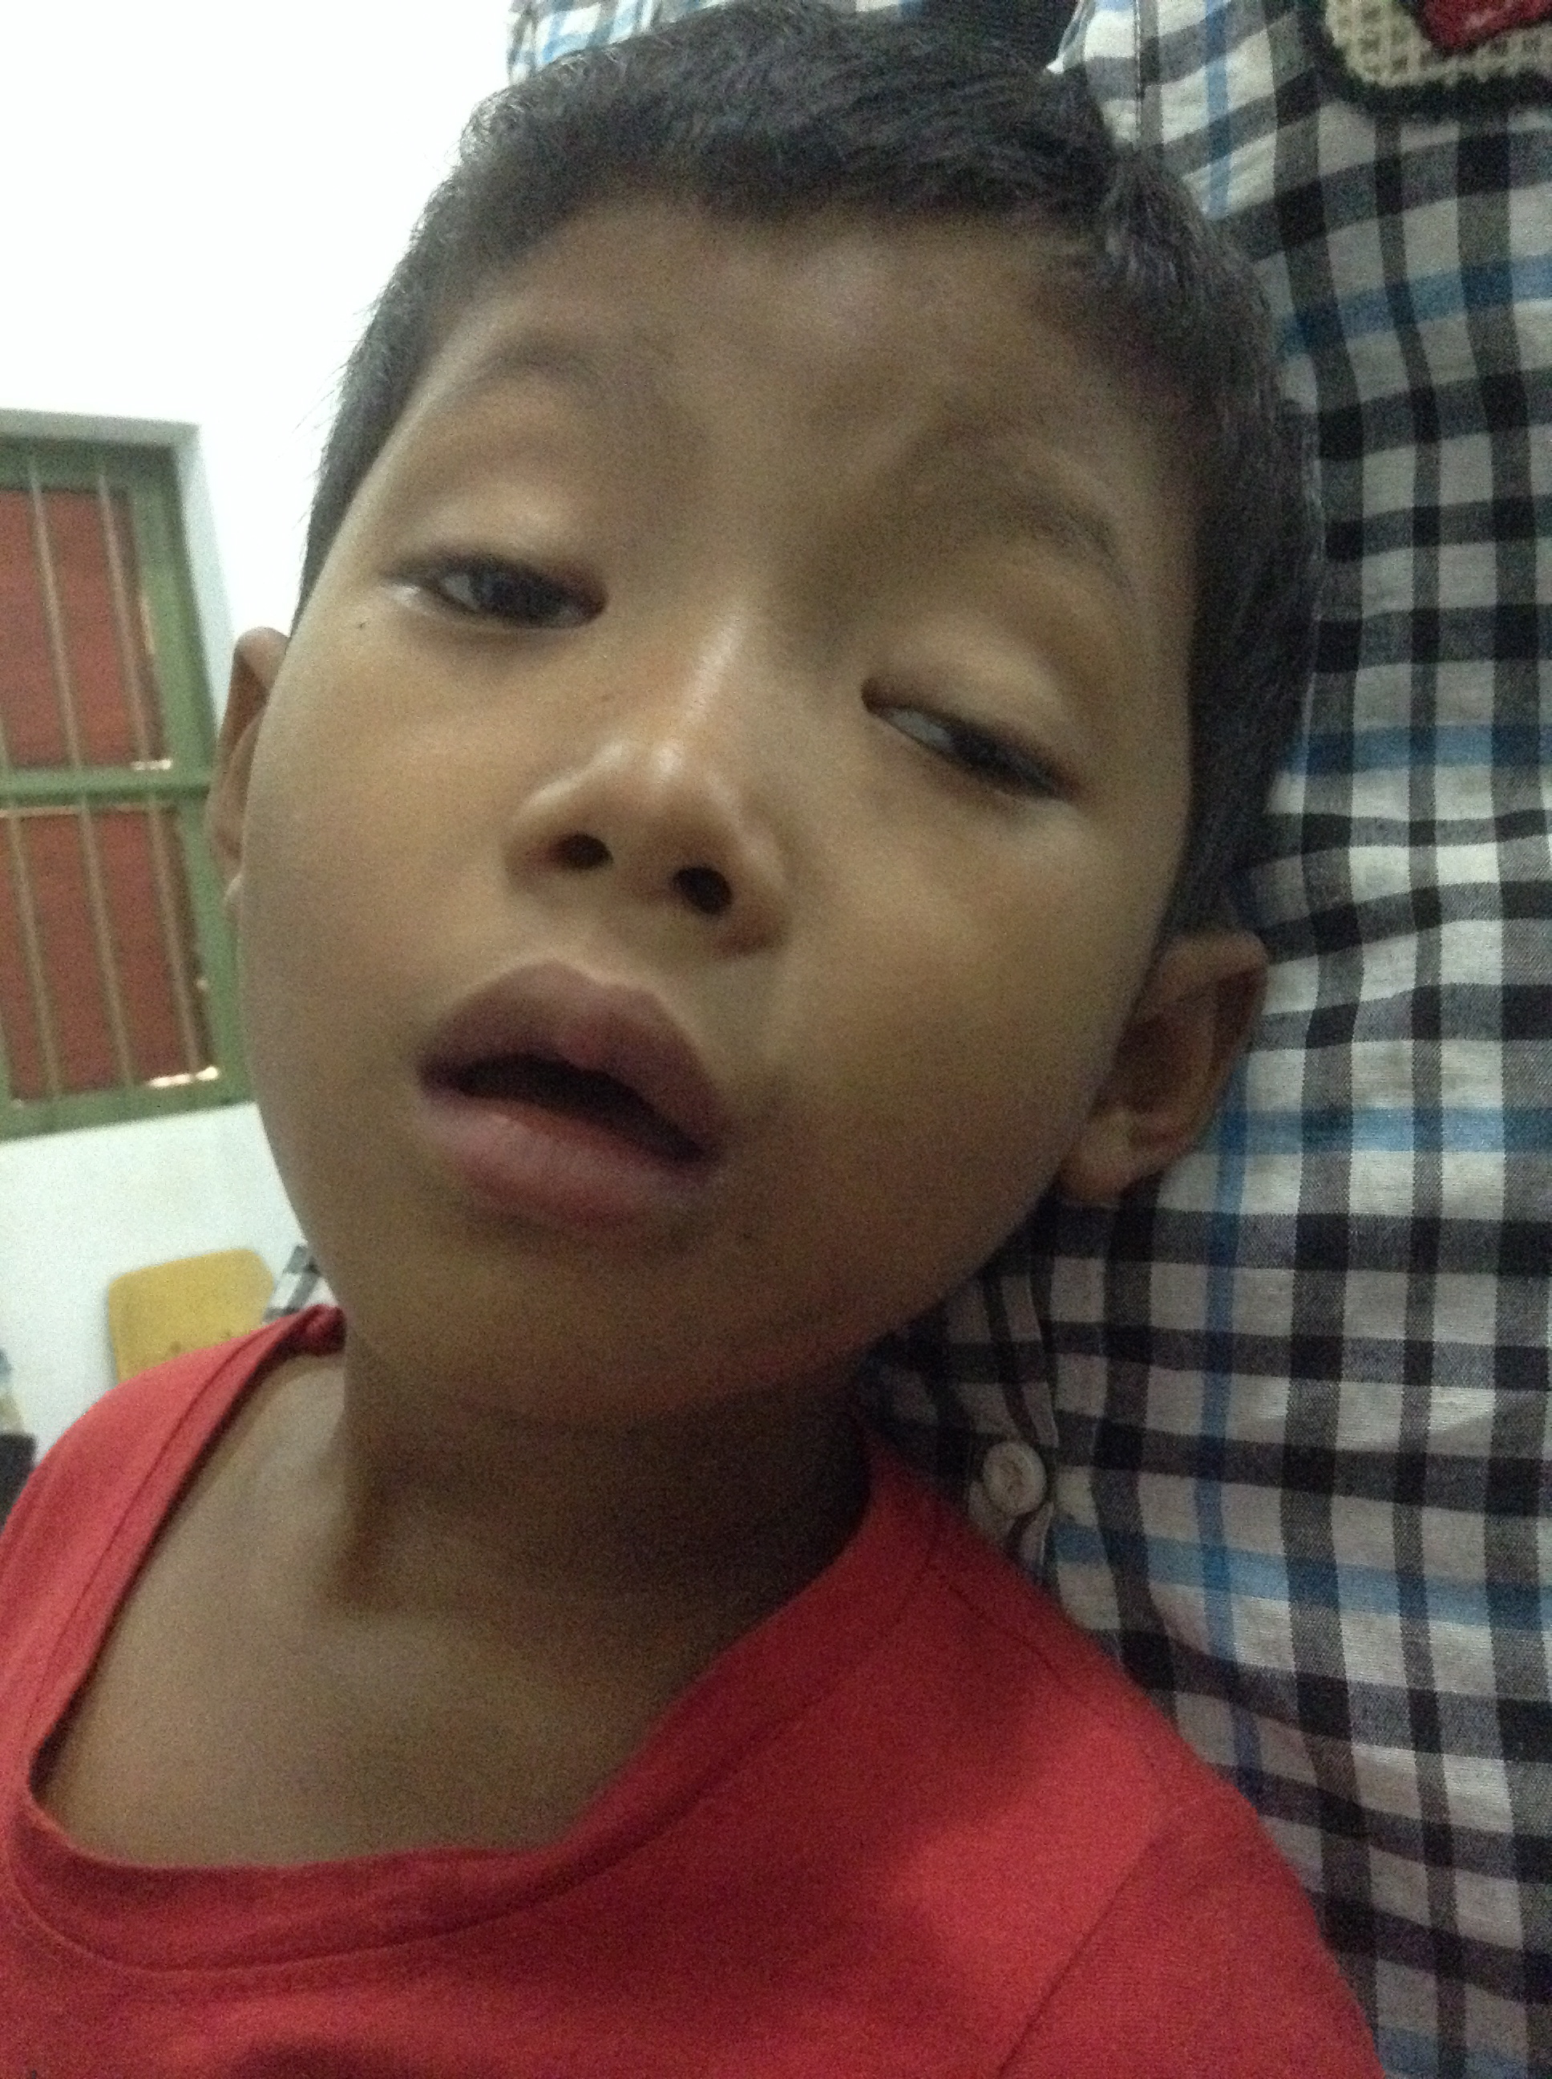
6 year old boy with ptosis x 2 months

Slide 10
History
Chief Complaint/HPI
Ocular history
Medical history
Current medications
Current allergies
Family/social history
Review of systems
Ptosis x 2-3 months, no diplopia, maybe its better morning or after rest
Notes:
No trauma, no recent infections

Slide 11
History
Often sick with multiple sinus and lung infections
Tired all the time, doesn't like to play sports
Chief Complaint/HPI
Ocular history
Medical history
Current medications
Current allergies
Family/social history
Review of systems
Notes:
No trauma, no recent infections

Slide 12
Ptosis in children
Congenital
Acquired
Aponeurotic
Mechanical
Neurological
Traumatic

Slide 13
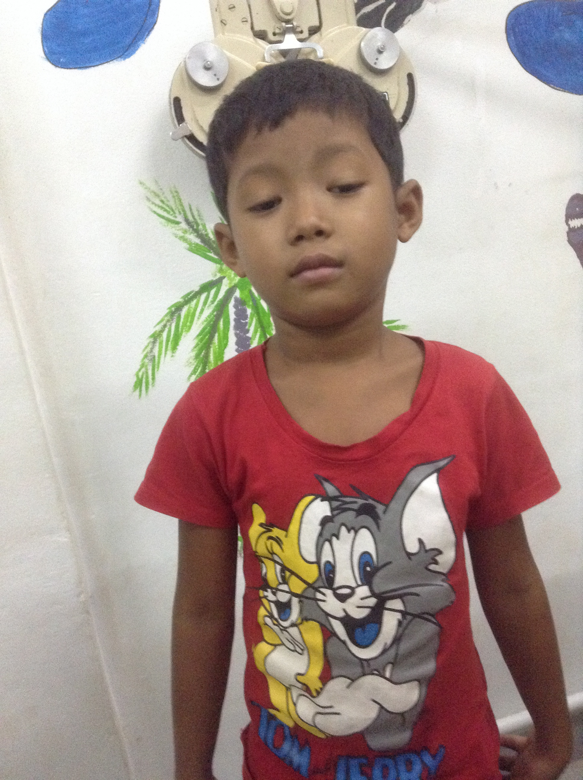
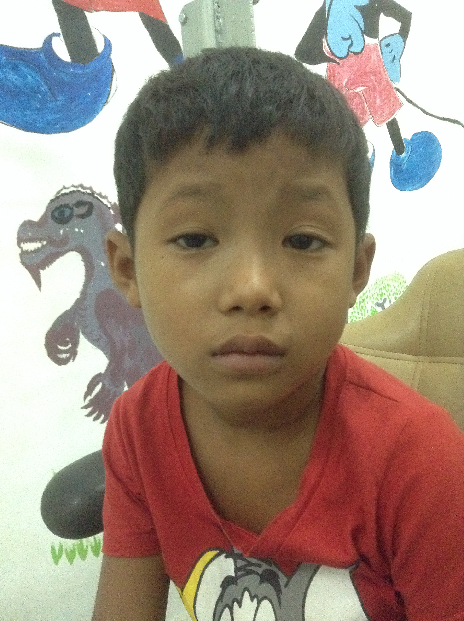
Physical Exam
6/12 and 6/12
Variable exotropia
EOM full
MRD 0/-1
PF 3.5/3
LF 5/6
Tires easily during exam
Diagnosis: Myasthenia Gravis

Slide 14
History
Often sick with multiple sinus and lung infections
Tired all the time, doesn't like to play sports
Chief Complaint/HPI
Ocular history
Medical history
Current medications
Current allergies
Family/social history
Review of systems
Notes:
No trauma, no recent infections

Slide 15
Myasthenia Gravis in Children Systemic Disease
A - Asthma exacerbations
B - Breathing difficulties
C - Choking
D - Drooling
E - Exercise intolerance
F - Facial weakness
G - Gradual increase in tripping or falling
M.C. Brodsky, M.D.

Slide 16
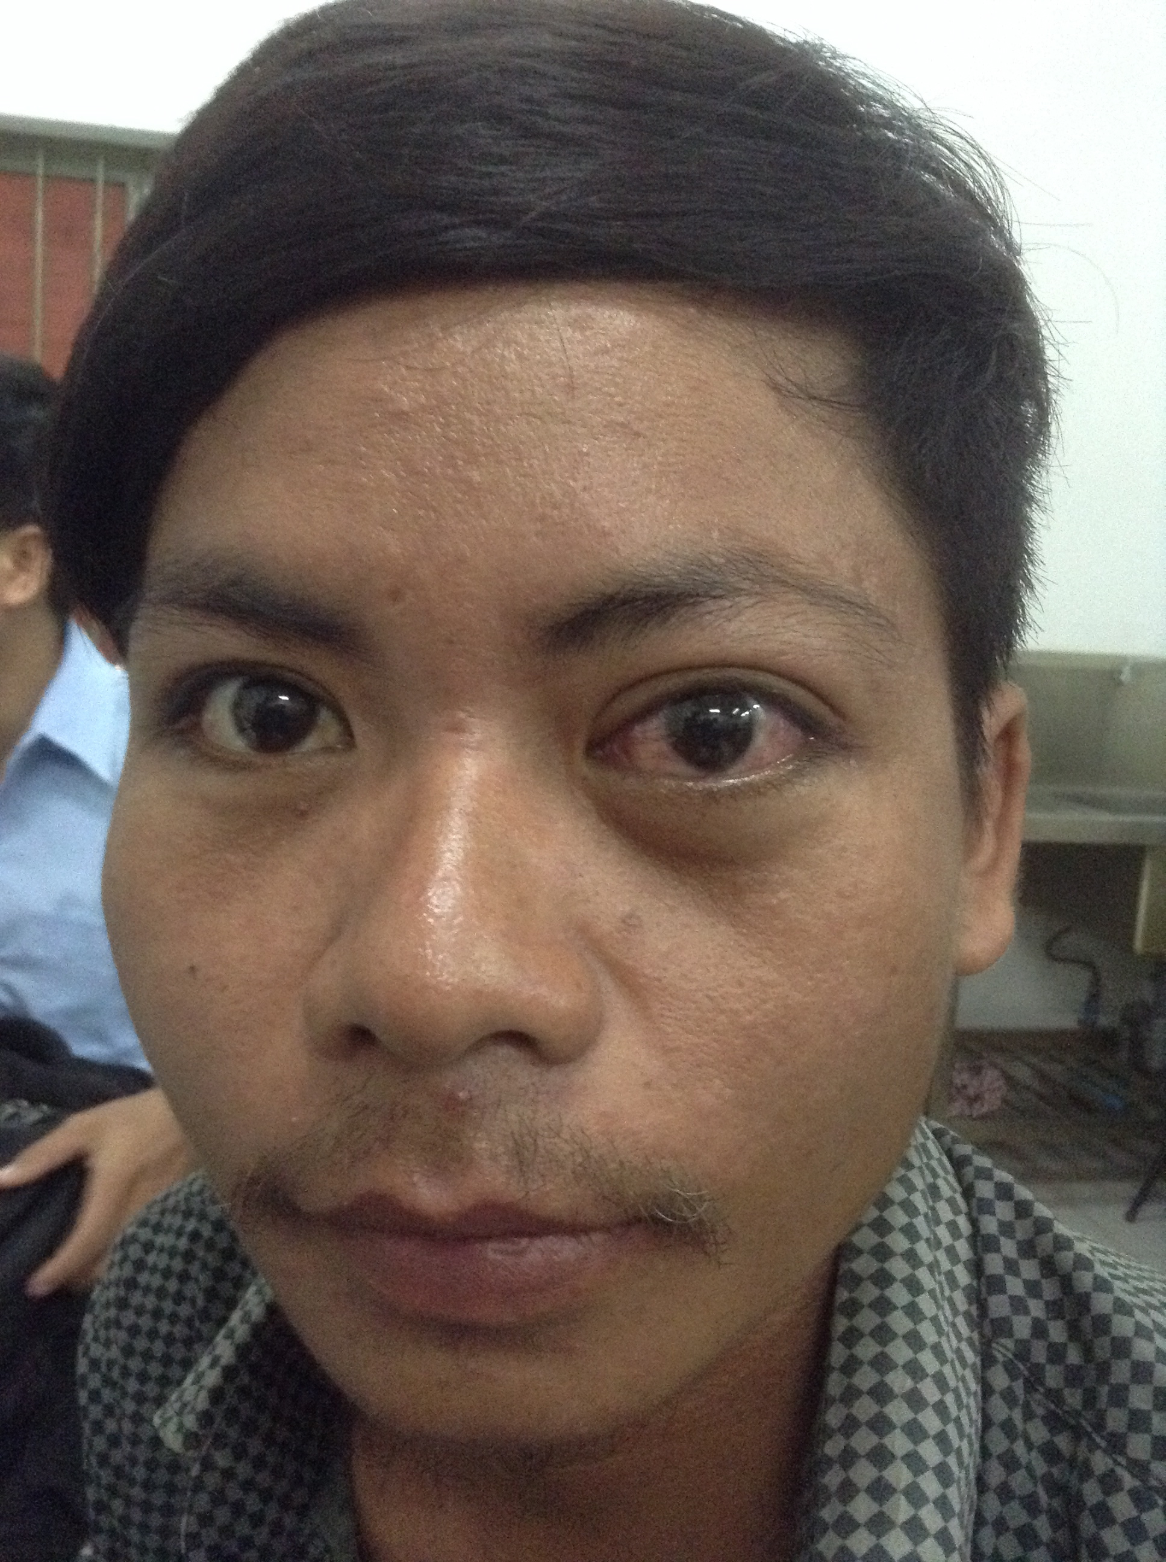
30 year old man with left eye pain

Slide 17
Pain
L – Location
I – Intensity
Q – Quality
O – Onset
R – Radiating
A – Aggravating factors
A – Alleviating factors
A – Associated factors

Slide 18
History
Chief Complaint/HPI
Ocular history
Medical history
Current medications
Current allergies
Family/social history
Review of systems
Left eye pain x2 weeks, deep rooted boring, non-radiating pain rated 8-9/10, aggravated by moving eyes, associated with blurred vision, alleviated by nothing
Notes:
No trauma, no recent infections

Slide 19
History
Chief Complaint/HPI
Ocular history
Medical history
Current medications
Current allergies
Family/social history
Review of systems
Diplopia
Photosensitivity
Halos around lights
Headache, bruit
Systemic inflammation
DM, Graves Disease
Crohn's, ankylosing
spondylitis, RA, SLE, Wegeners
Notes:
Review of systems addresses differential diagnosis

Slide 20
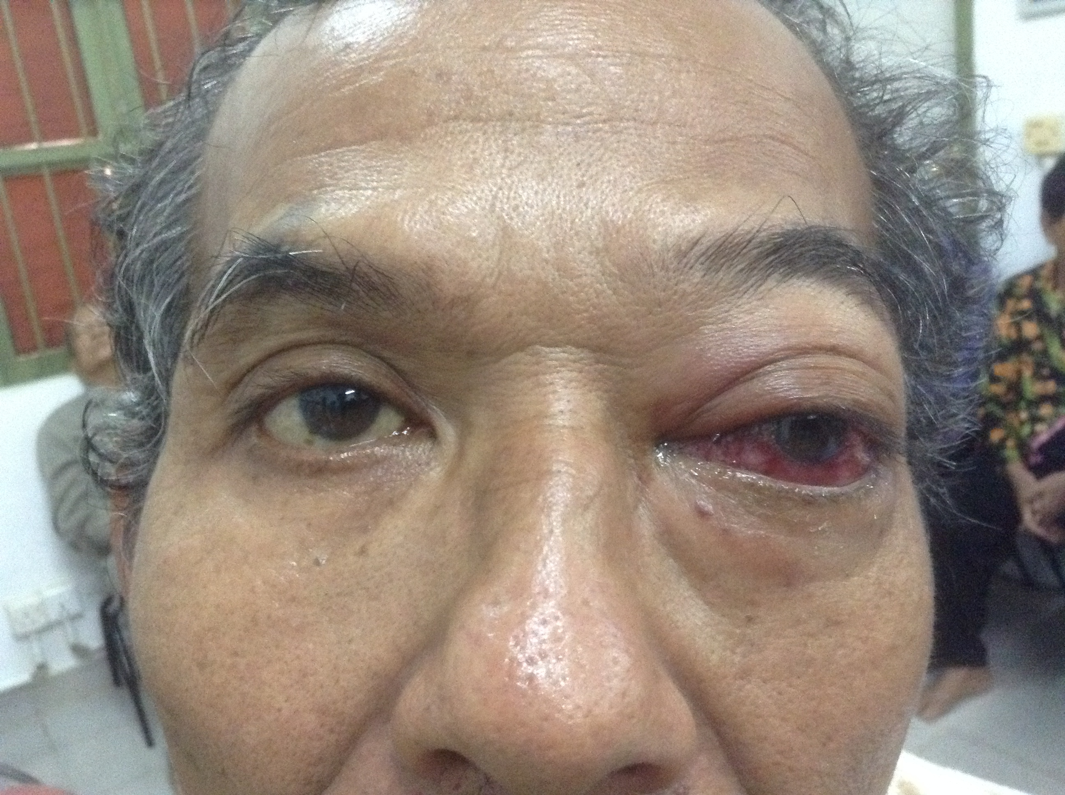
58 year old man with left eye pain

Slide 21
History
Chief Complaint/HPI
Ocular history
Medical history
Current medications
Current allergies
Family/social history
Review of systems
Throbbing entire left eye with proptosis, gradually worse x2 years, feels tight and swollen, nonradiating with associated headache, worsened when lifting things. Seen in Vietnam for conjunctivitis, steroids didn't help
Notes:
No trauma, no recent infections

Slide 22
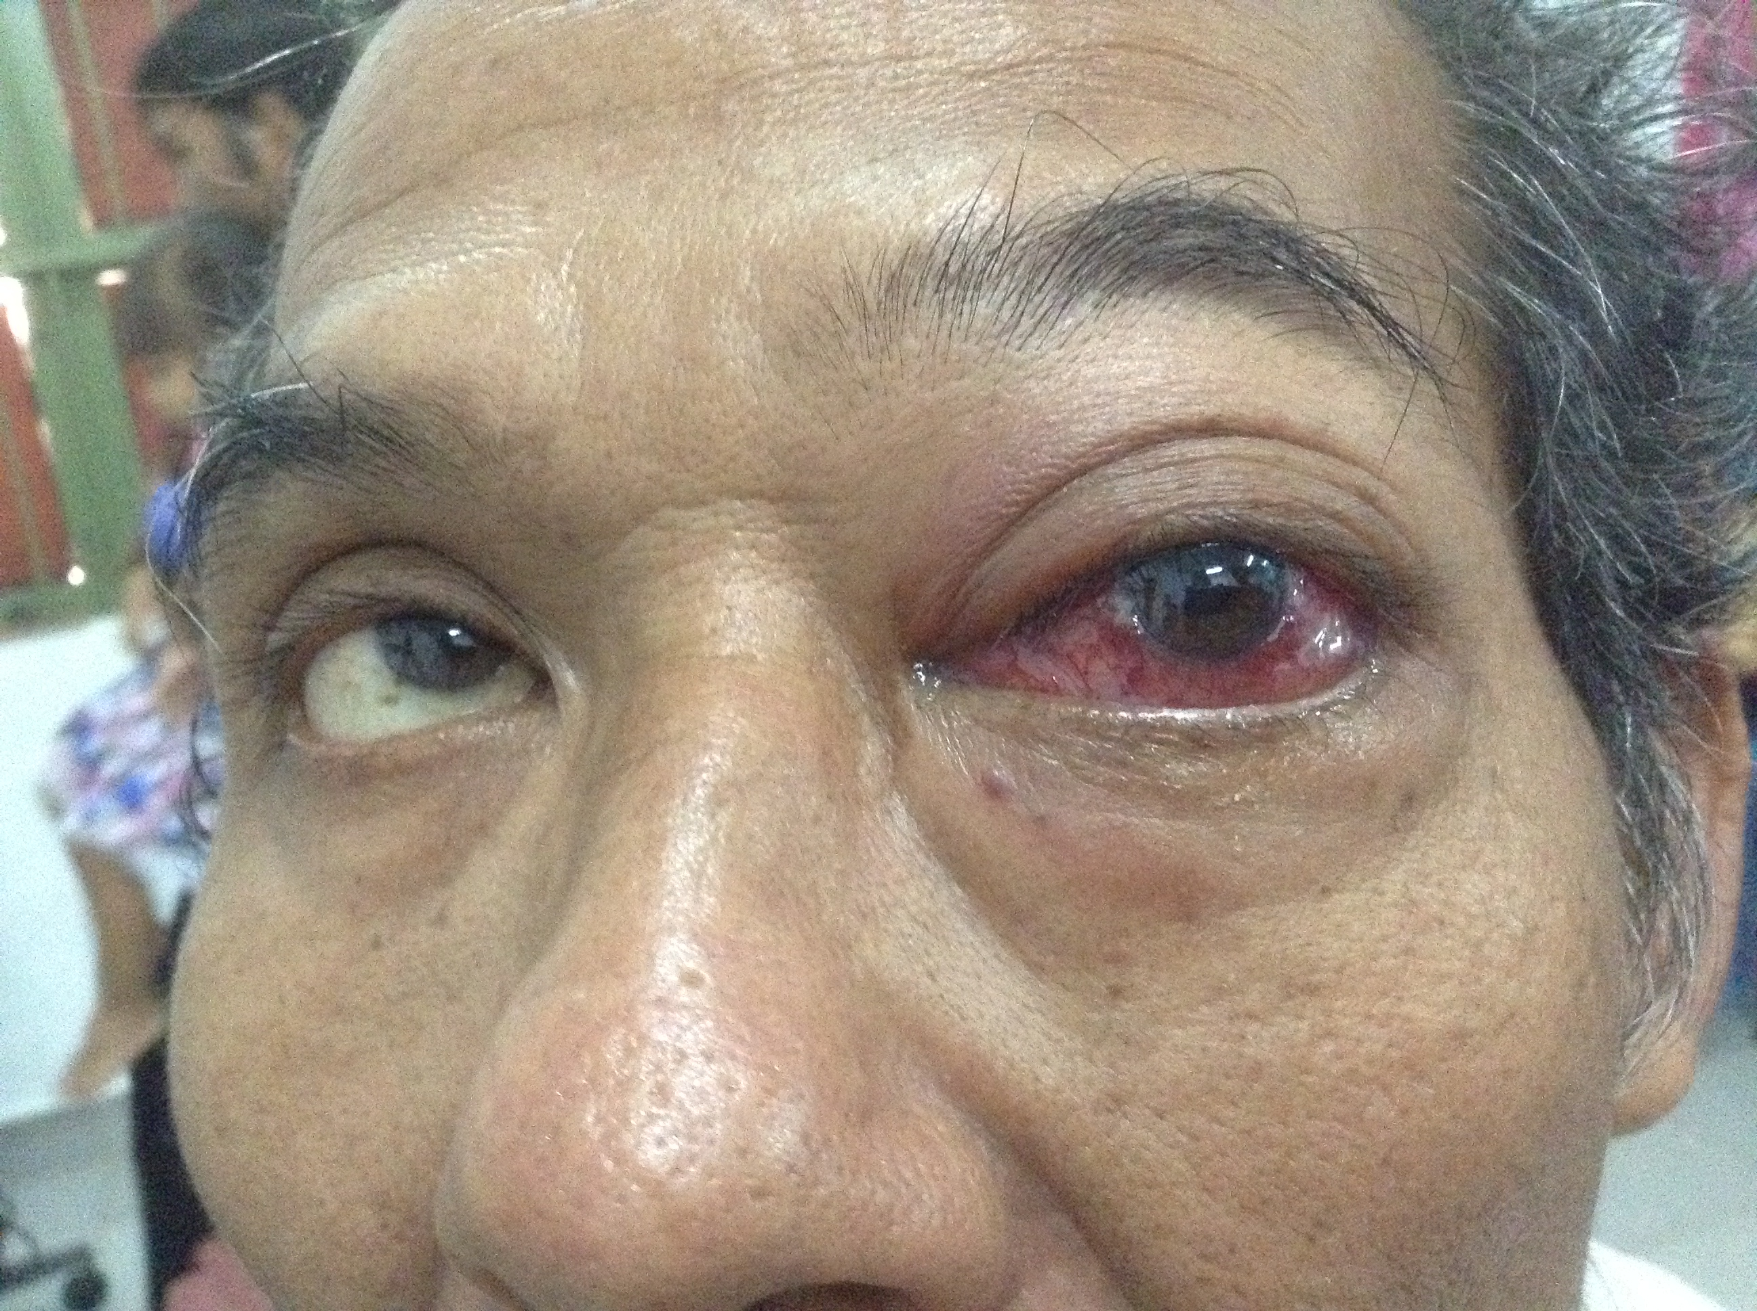
Other History?
-Decreased vision
-Diplopia in upgaze
-No light sensitivity
-Sometimes dim vision, no glare or halos around lights
-No bruit
History of head trauma 3 years ago
10mg prednisone PO
No Med Hx, ROS neg

Slide 24
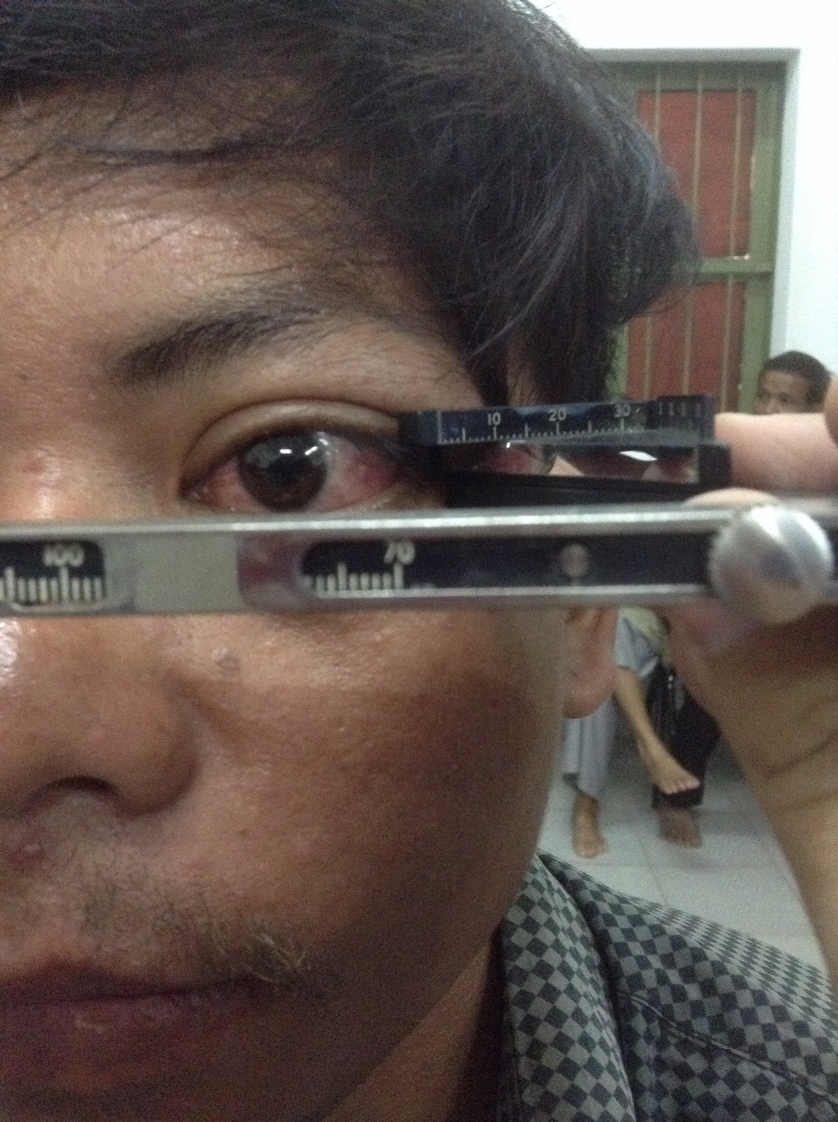
Physical exam
VA: 6/6 and 6/9
IOP 12/13
Pupils normal, no APD
Full EOM, no lid lag
3mm proptosis
Conj/episcleral injection
AC deep & quiet
c/d 0.2, no disc edema
Normal fovea reflex

Slide 25
Physical exam
VA: 6/6 and 6/36
IOP 14/26
Left APD
Restricted upgaze OS
3mm proptosis
Injection, chemosis
K clear, AC deep & quiet
c/d 0.3/0.6, no disc edema
Normal fovea reflex

Slide 26
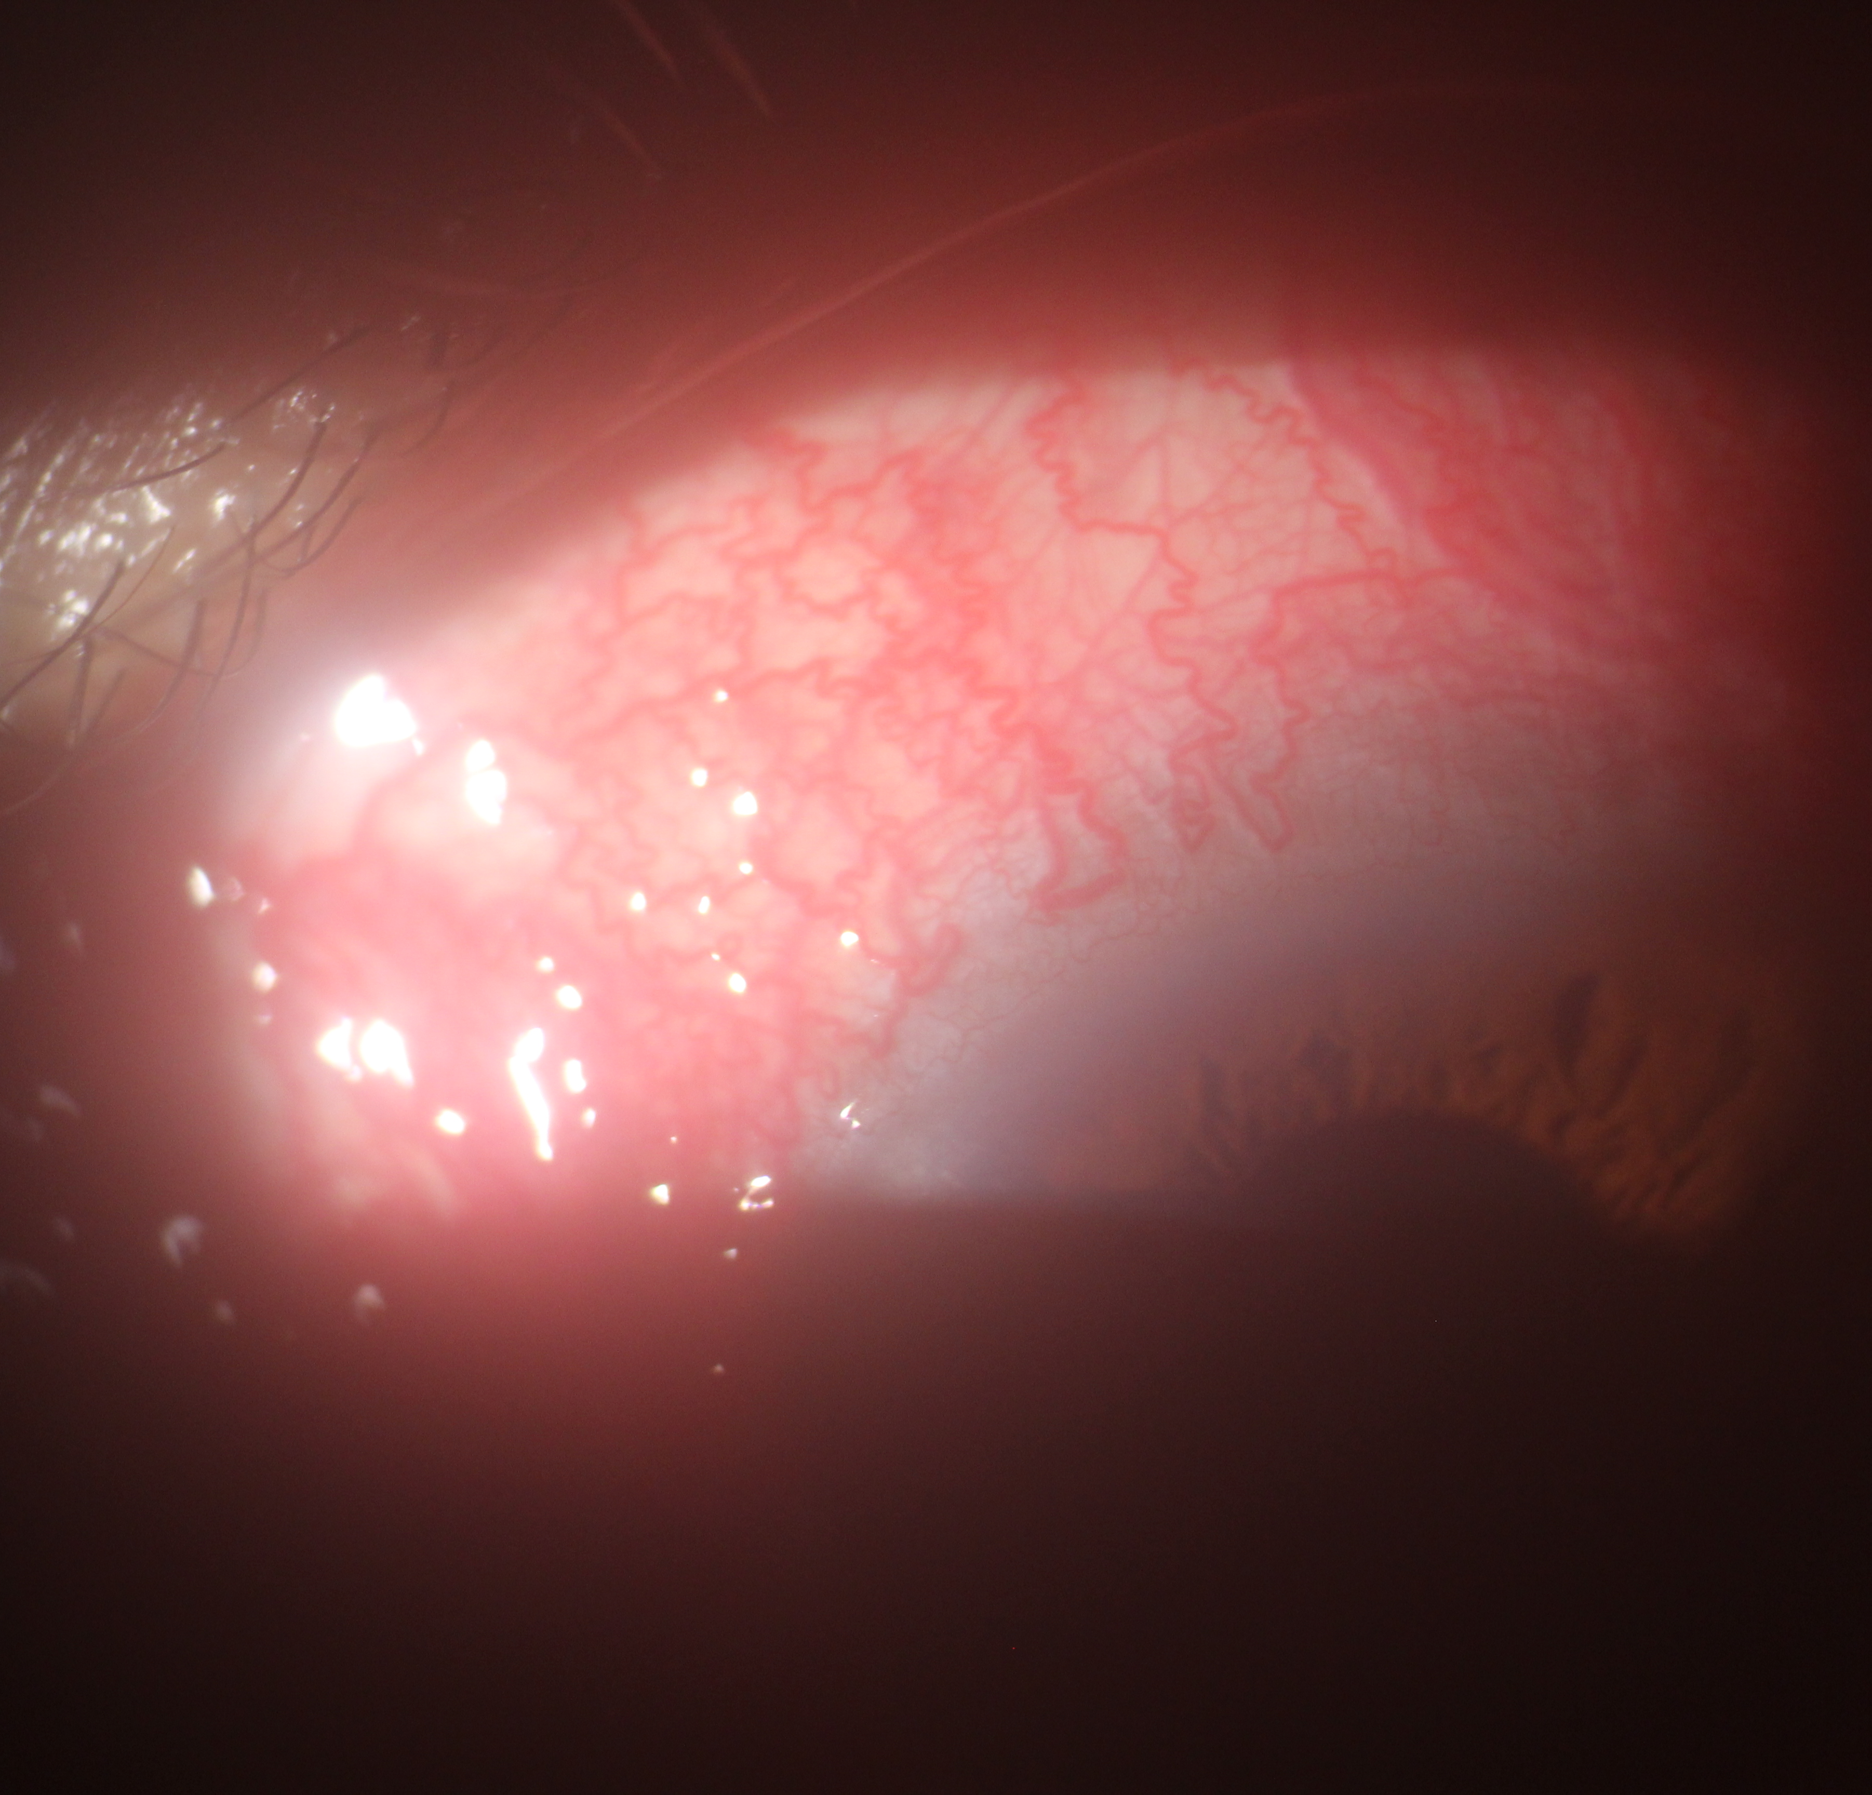
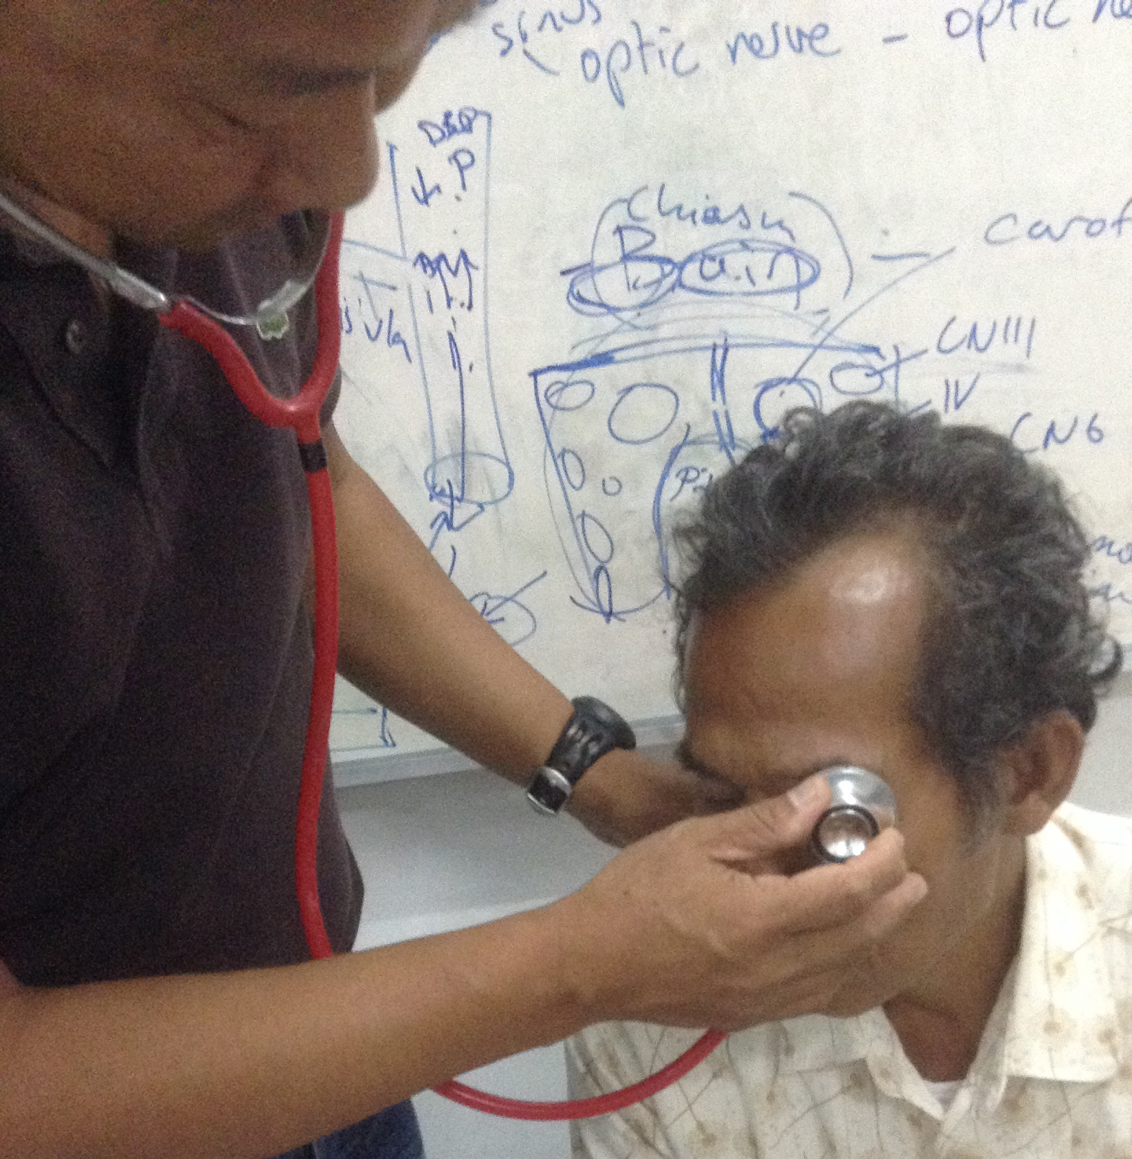
Notes:
10% have bruit over the temporal bone
Dynamic tonometry present more often—watch the mires move on the goldmann tonometry

Slide 27
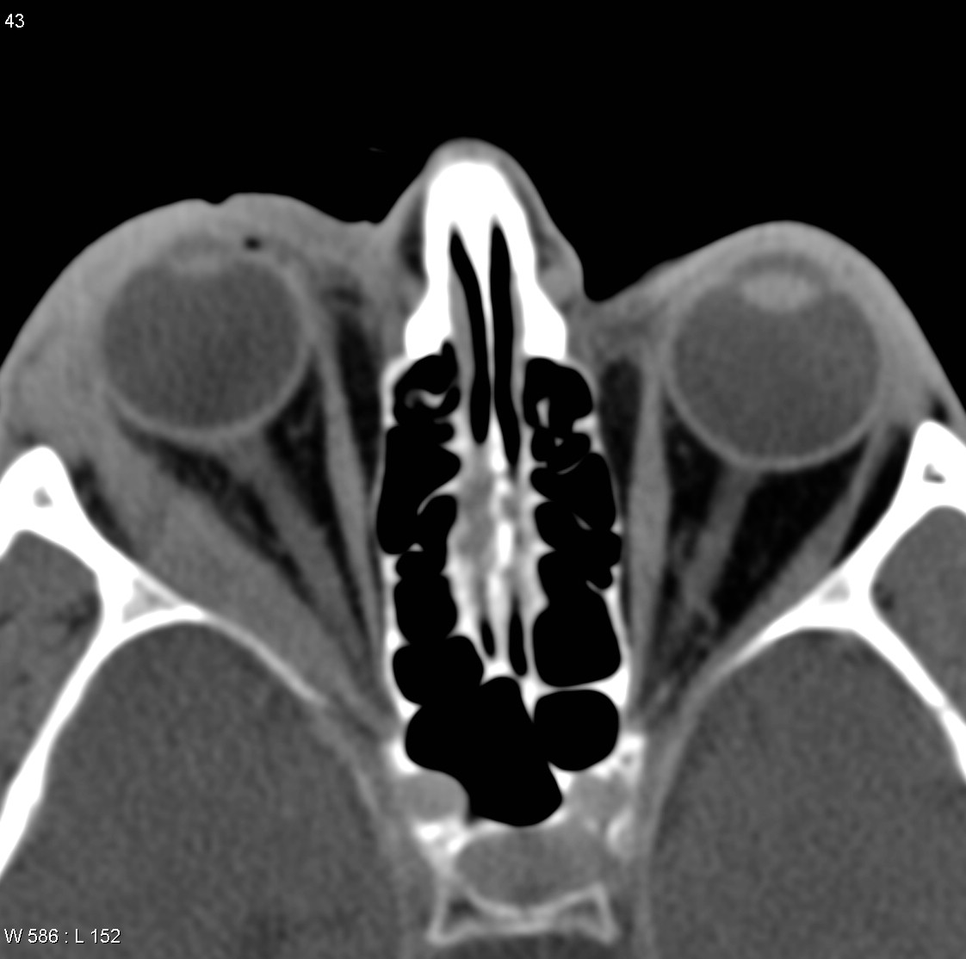
Notes:
CCF: Diffuse enlargement of muscles with characteristically enlarged SOV

Slide 28
Diagnosis and Management
-Carotid cavernous fistula
>Selective arteriography with embolization of fistula with intra-arterial/venous coils
-Non-specific orbital inflammation
>High dose oral steroids

Slide 29
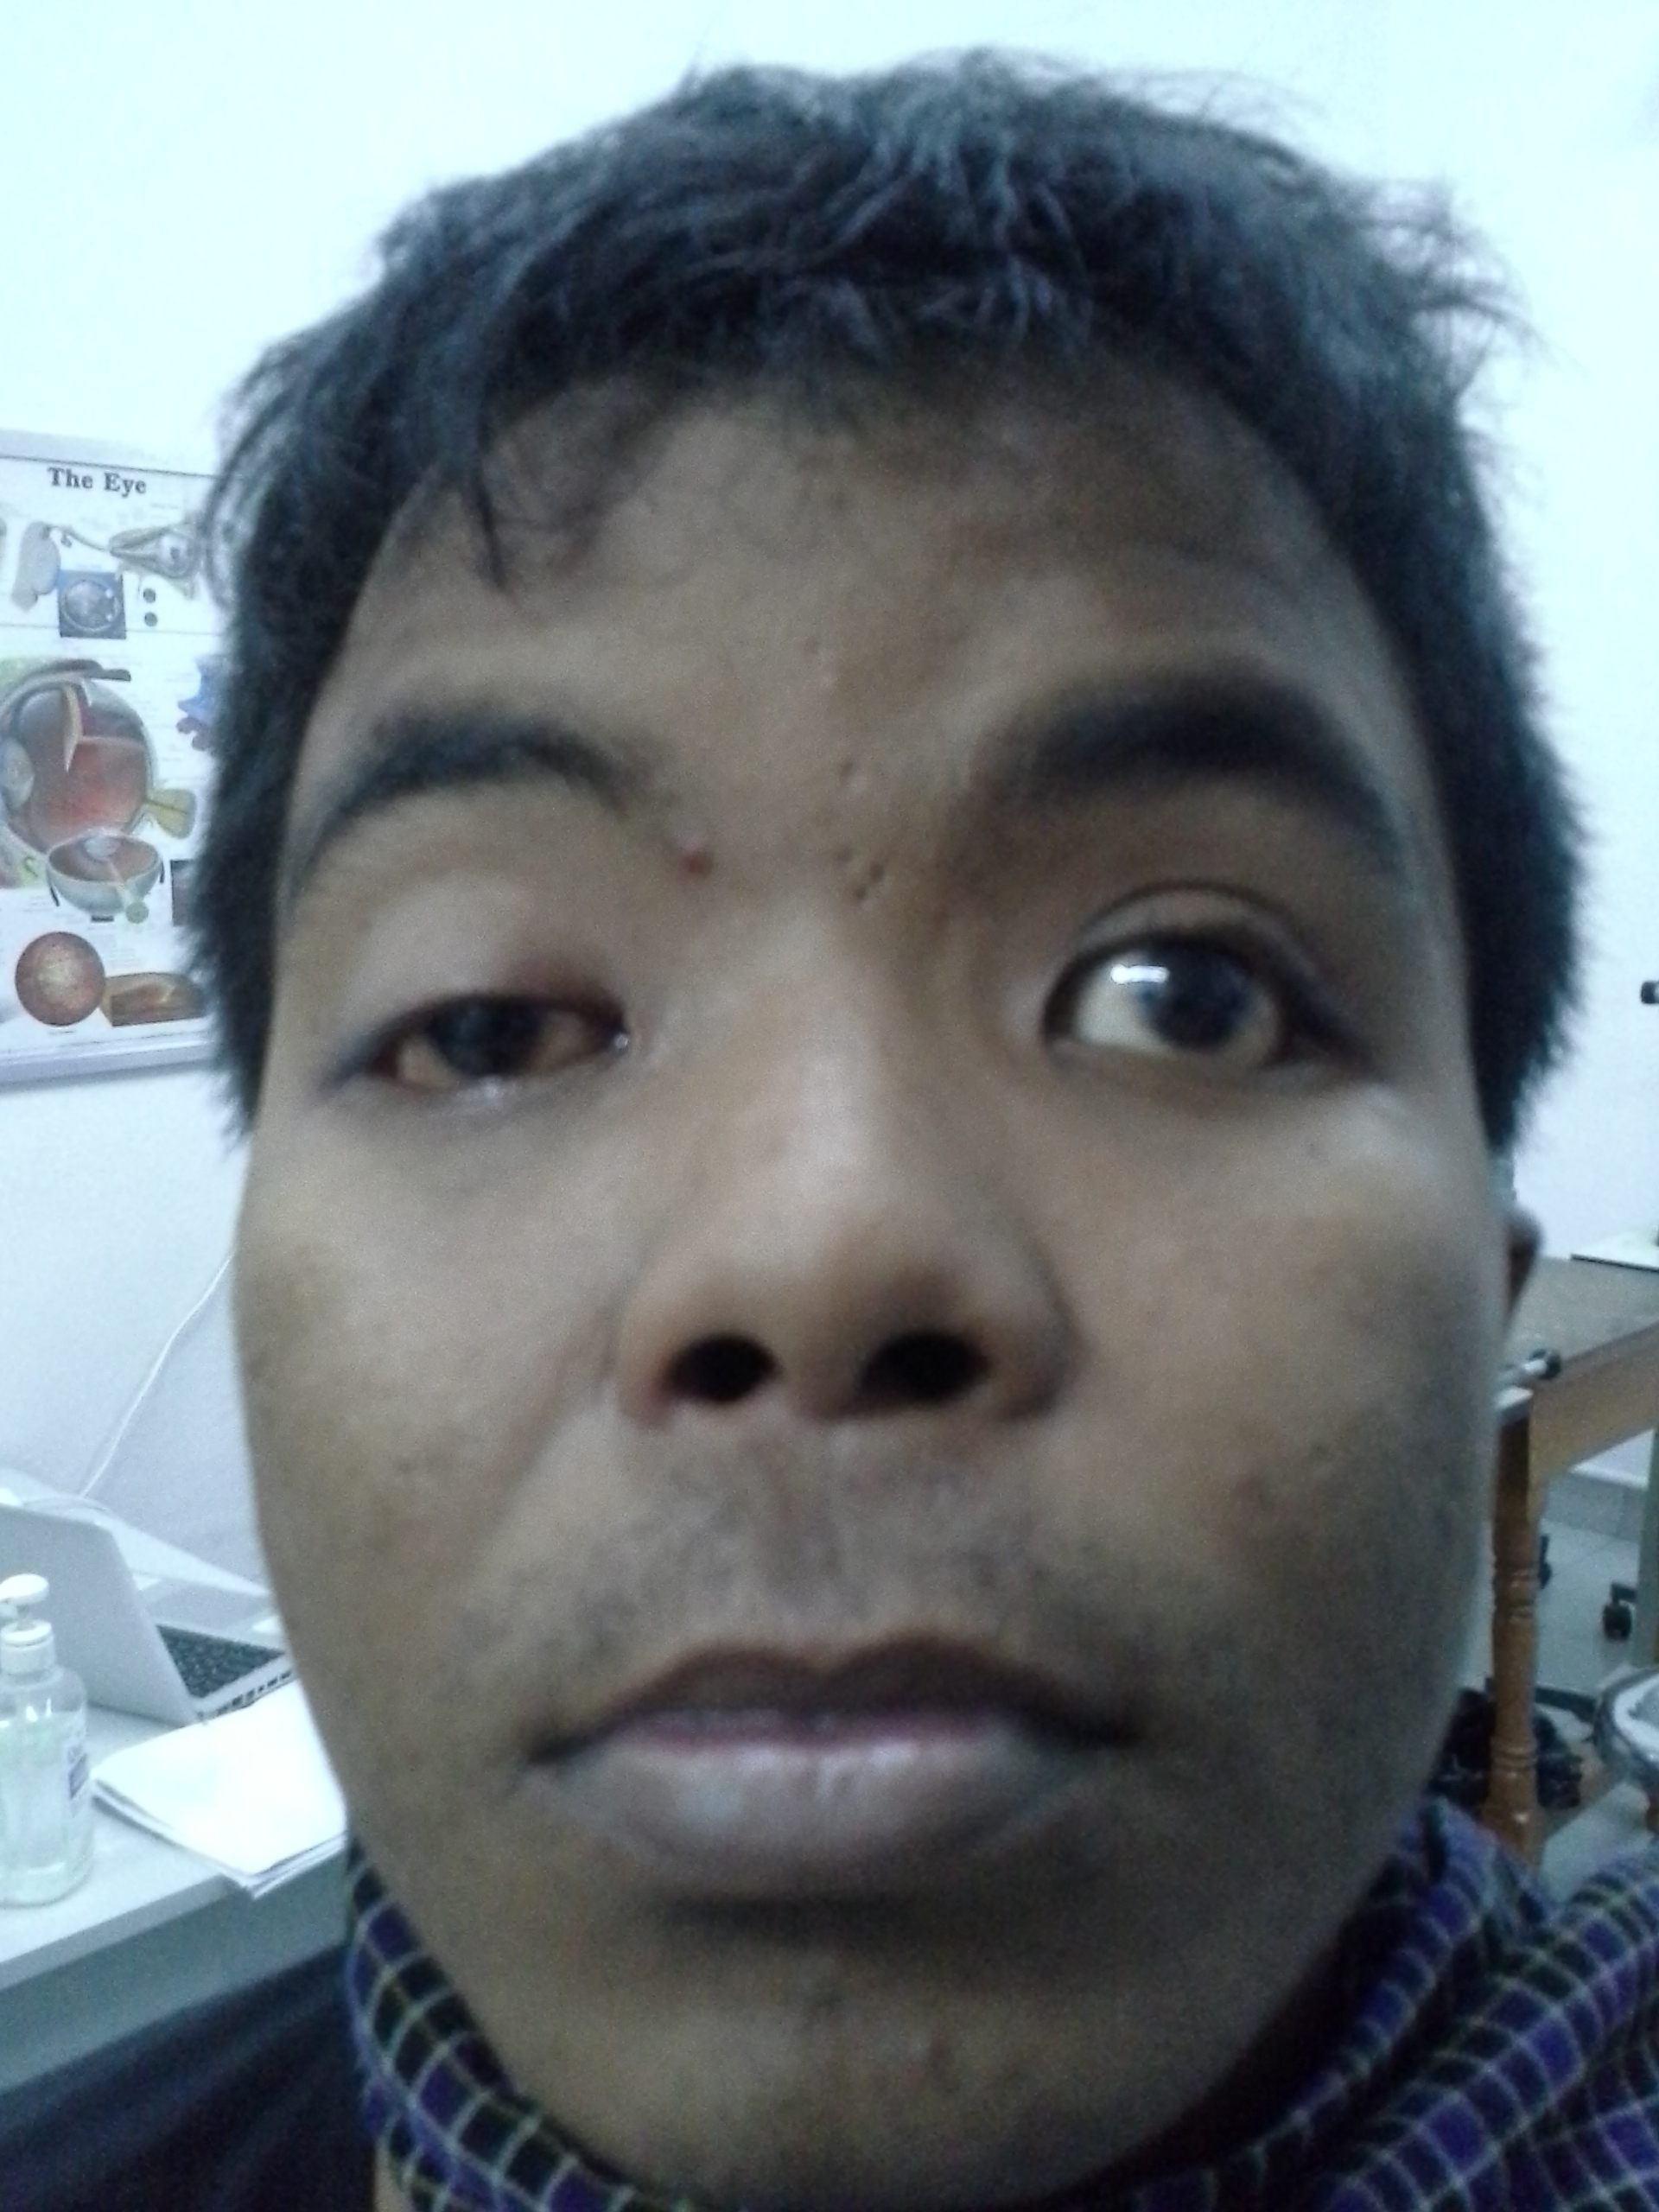
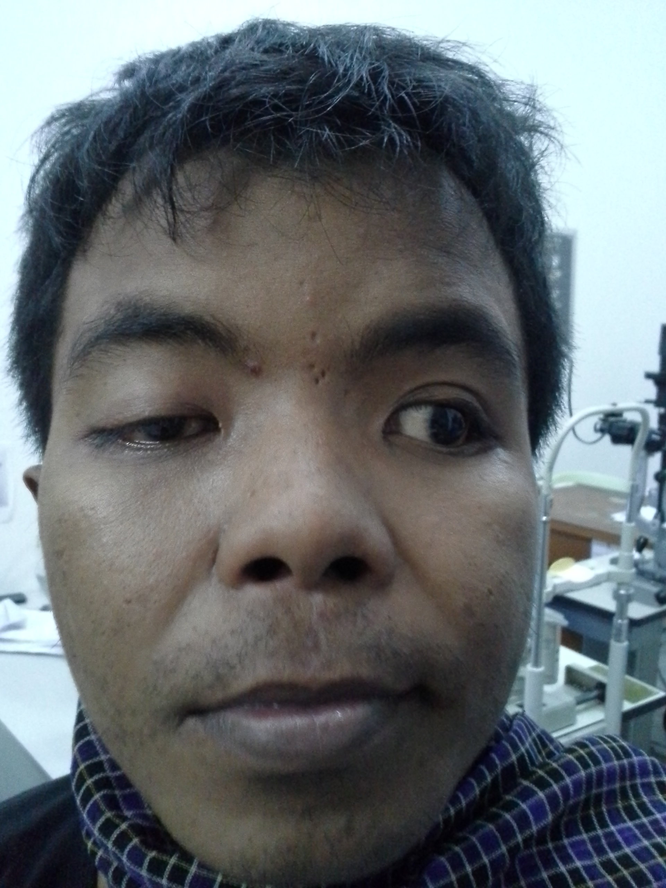
29 year old man with blurred vision OD

Slide 30
History
Chief Complaint/HPI
Ocular history
Medical history
Current medications
Current allergies
Family/social history
Review of systems
Blurred VA, pain OD x 3-4 days, no trauma
No medical Hx, no meds, no allergies

Slide 31
29 year old man with blurred vision OD
Blurred VA or diplopia?
When did ptosis start?
Pain: surface or retrobulbar? Onset?
Headache? Neurological problems?
Sinus problems? Difficulty chewing or swallowing?

Slide 32
Physical exam
VA: 6/18 and 6/6
Pupils: sluggish OD, 5/5 dark, 4/3 light, no APD
Complete ophthalmoplegia OD, -1 abduction deficit OS
PF 3/11, MRD1 -2/+4, Lid excursion 0/8
Hertel 17/16@105
Cornea clear, AC quiet, lens clear
Fovea normal c/d 0.1 no edema OU
Cranial nerve 5, 7, 8, 12 intact

Slide 33
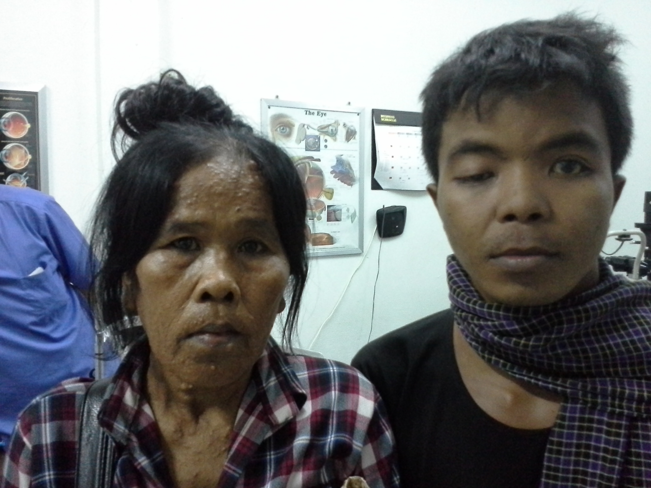
Family History?

Slide 34
Physical Exam
Lisch nodules
Plexiform neurofibromas
Pulsatile exophthalmos
Prominent corneal nerves
Choroidal hamartomas
Cafe-au-lait spots
Neurofibromas
Notes:
Lisch nodules 95% by age 20
Absence of greater sphenoid wing-pulsatile exophthalmos

Slide 35
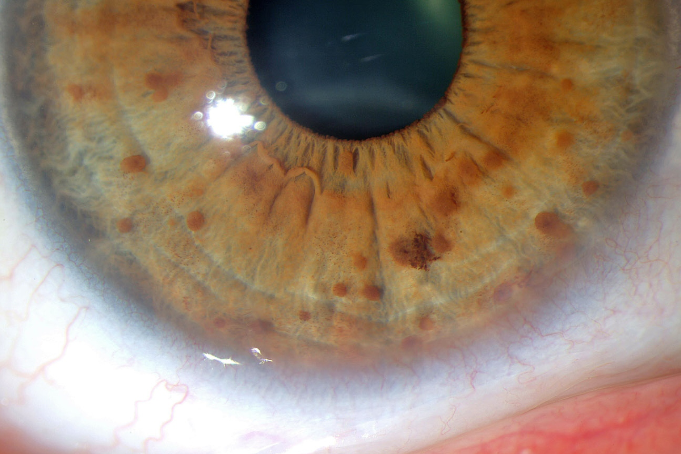
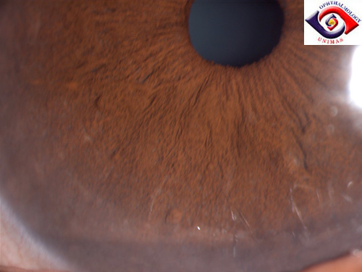
Lisch nodules
Notes:
A 50 year-old woman with type 1 neurofibromatosis had multiple Lisch's nodules on the iris. Unlike the yellow lesions seen in Europeans, the Lisch's nodules in Asian patients tend to be brow or dark due to the presence of melanin

Slide 36
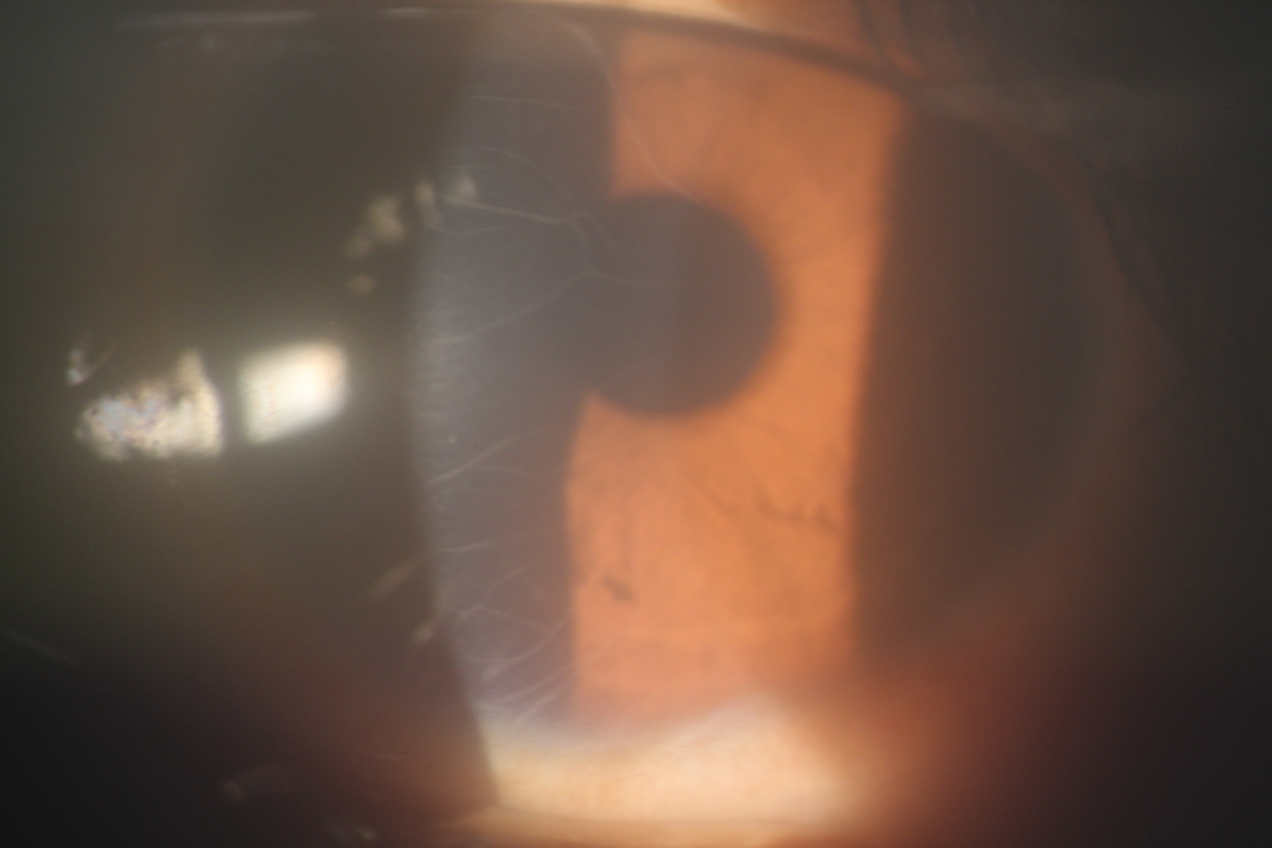
Prominent corneal nerves

Slide 37
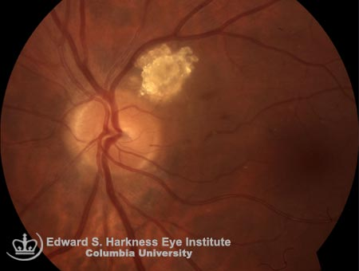
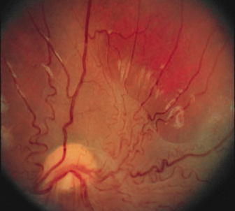
Funduscopic findings in NF1

Slide 38
Ancillary Testing and Differential Diagnosis
Acute/subacute presentation of cranial nerve 3, 4, 6 palsy with ?partial pupil and optic nerve involvement
Orbital apex versus cavernous sinus lesion
Optic nerve glioma versus sphenoid wing meningioma
CT orbits, brain
Skull X-ray

Slide 39
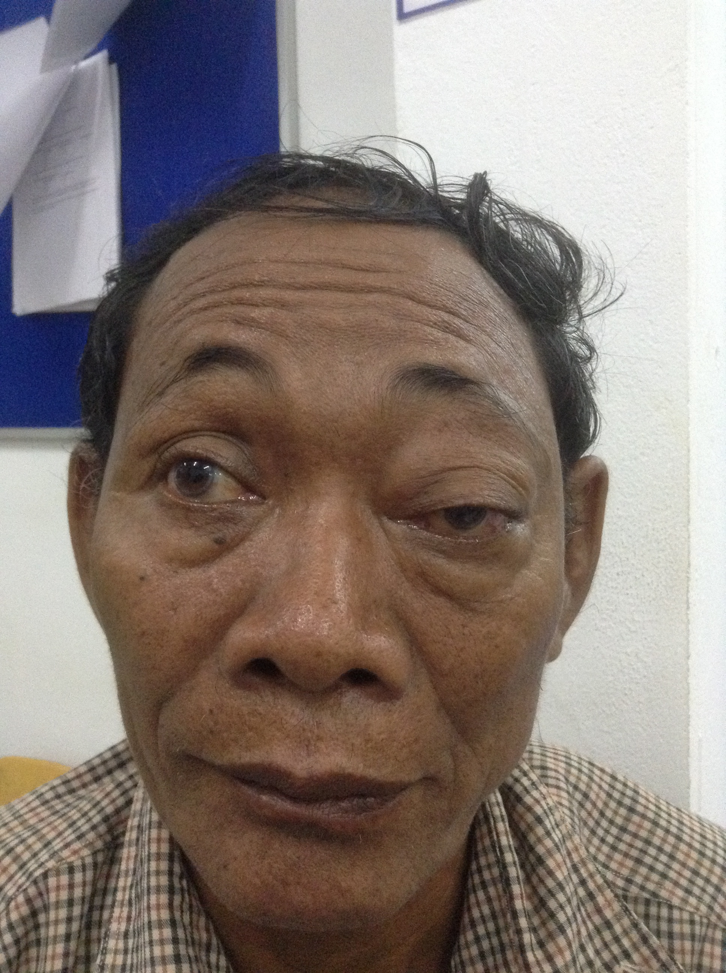
61 year old man with left eye pain

Slide 40
History
Chief Complaint/HPI
Ocular history
Medical history
Current medications
Current allergies
Family/social history
Review of systems
Left eye irritation x3 months, worse now with constant foreign body sensation, swelling around the eye. Vision NPL OS x1 year. Gradual proptosis x3 years.
Notes:
No trauma, no recent infections

Slide 41
History
Chief Complaint/HPI
Ocular history
Medical history
Current medications
Current allergies
Family history
Review of systems
Diabetes
Diet controlled
Smoke cigarettes
Weight loss, fatigue, skin darkening, lumps on his shoulders, poor memory
Notes:
No trauma, no recent infections

Slide 42
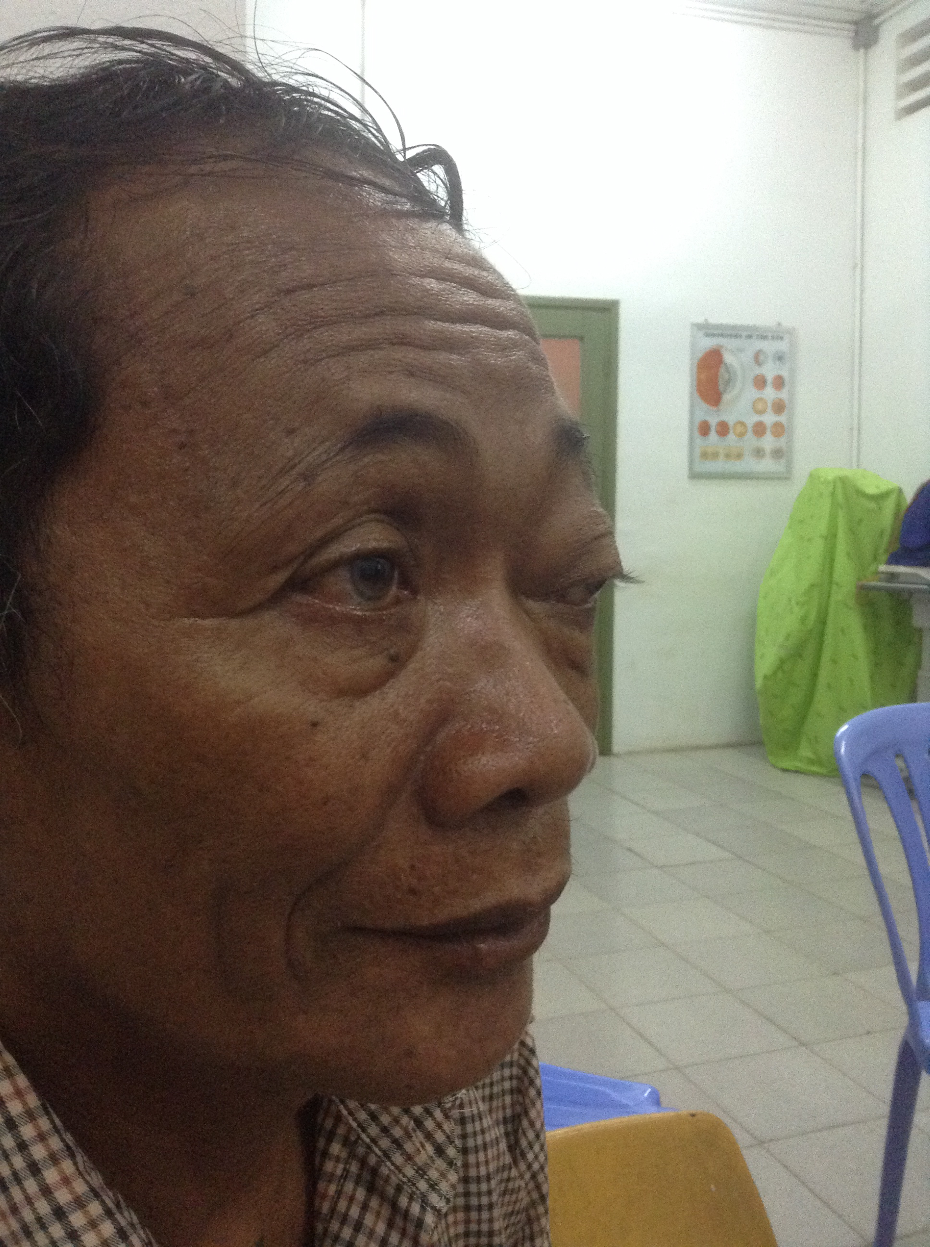
Physical Exam
VA: 6/18 and NPL
IOP: 16, 22
Left APD
Limited adduction, upgaze OS
8 mm proptosis, tight eyelid with 2mm ptosis
Moderate injection
K epi irregular, AC deep & quiet
c/d 0.3/4, disc pallor OS
Retina flat

Slide 43
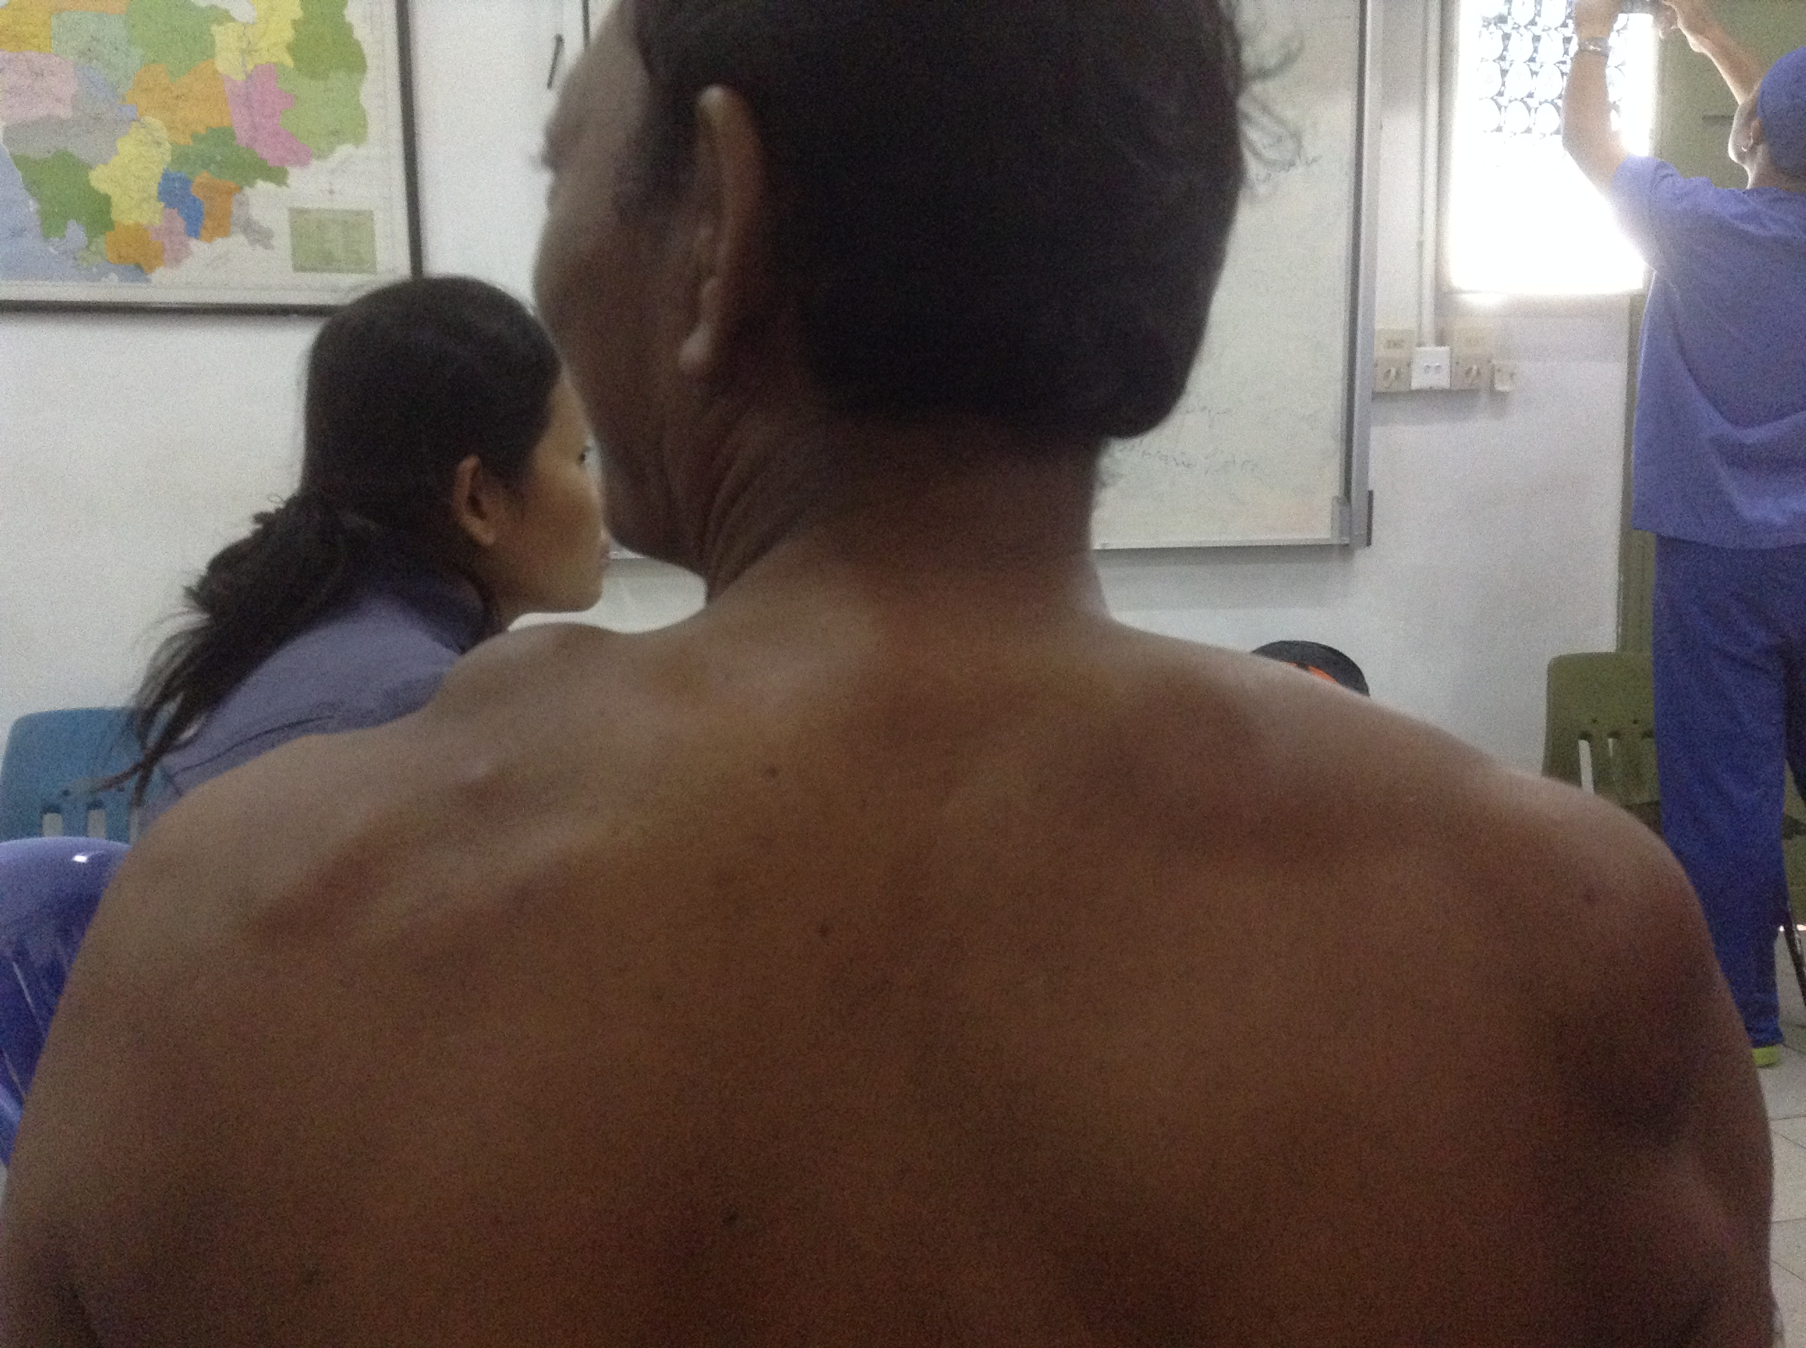
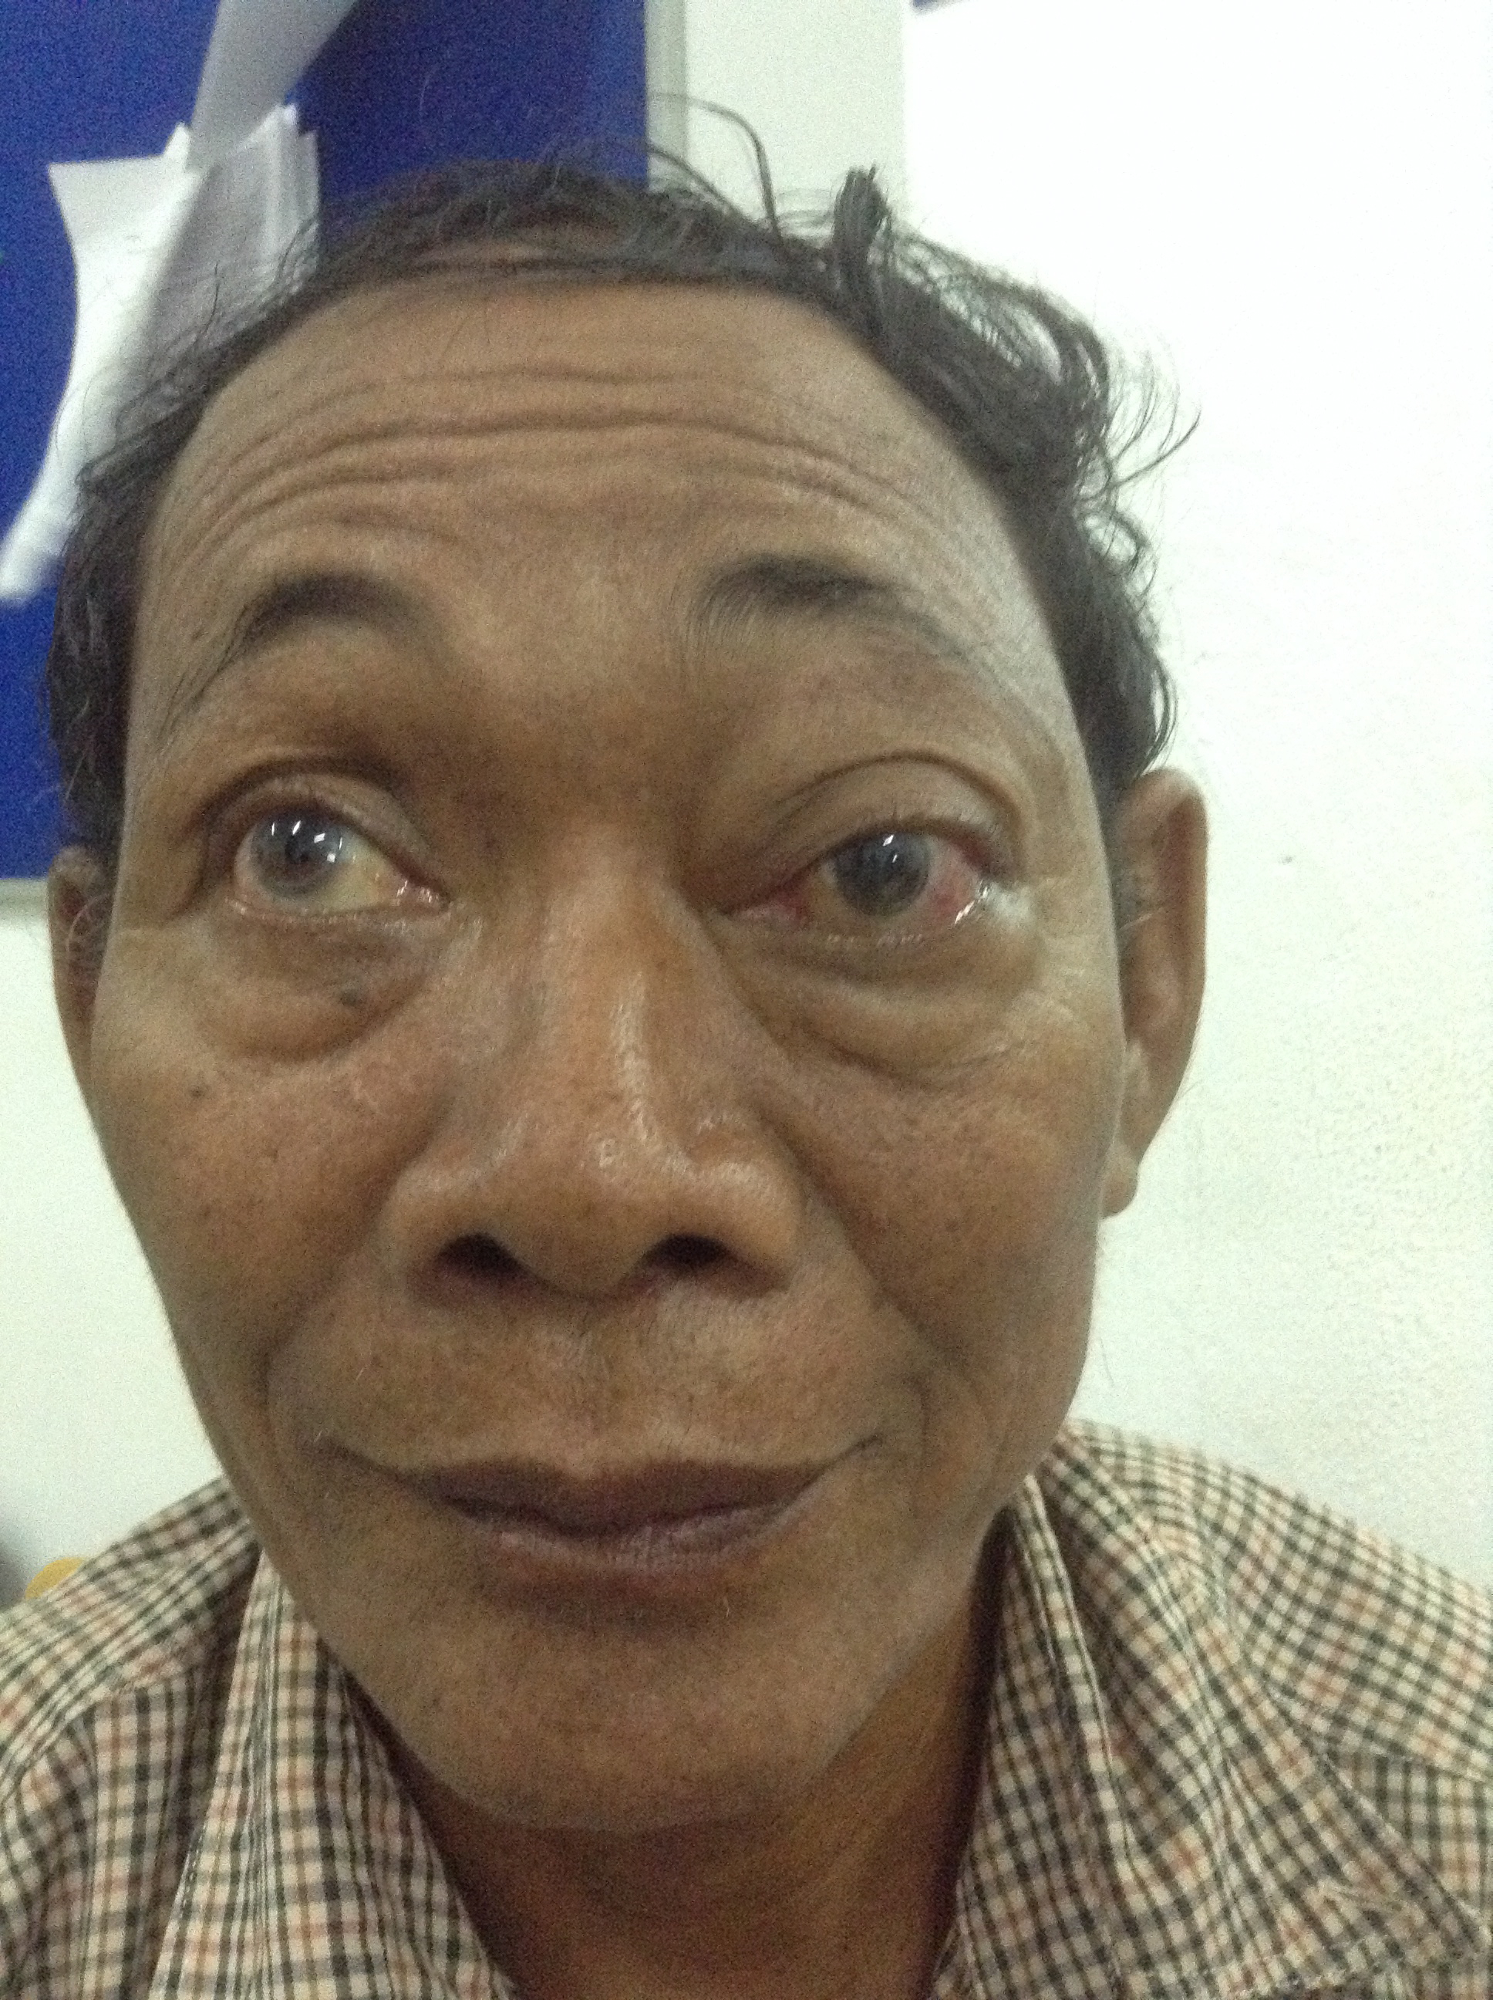

Slide 44
Differential Diagnosis 61 yo man with NPL vision x 1yr, partial ophthalmoplegia, proptosis x 3 yrs, with constitutional symptoms, lymphadenopathy and growing sub-cutaneous masses
Metastasis
Lymphoma
Meningioma
Rhabdomyosarcoma
Hemangioma
Neurofibromatosis
Orbital tuberculosis

Slide 45
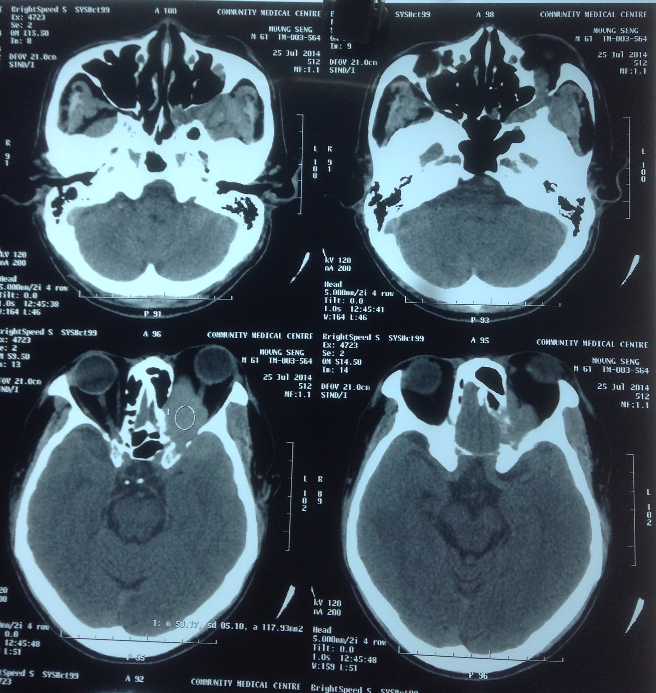
Tissue is the Issue: medial orbitotomy, incisional biopsy
Non-hodgkin lymphoma on the shoulder
?Small B cell lymphoma in orbit
>Path needs immunomarkers for definitive diagnosis

Slide 46
In Summary
A focused complete history is crucial first step for patient evaluation
Don't forget the connection of ophthalmic disease and systemic disease!
Review of systems helps to address your differential diagnosis and makes sure you don't miss anything
A focused physical exam confirms the patient's history.

Slide 47
References
Burch HB; Life-threatening thyrotoxicosis. Thyroid Storm. Endocrinol Metab Clin North Am 1993;22(2):263-77
Smith R; Thoughts for new medical students at a new medical school. BMJ. 2003 Dec 20;327(7429):1430-3.
www.sarawakeyecare.com/Atlasofophthalmology
http://150years.mayoclinic.org/history/quotations/the-doctors-mayo.php

Slide 48
Questions?

